Slide 1
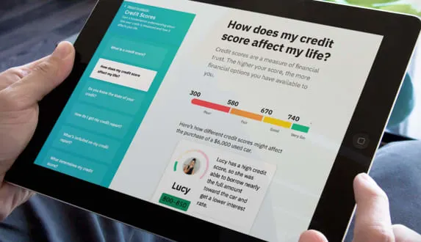
YOUR PROGRAM NAME HERE
YOUR LOGO HERE
FREE DIGITAL LESSONS
Learn how to manage and grow your money with [PROGRAM NAME]!
[PROGRAM NAME] is a digital financial education program designed to help you better manage your money. Get started today and take the first step in preparing for your financial future.
w
Learn More About:
Auto Loans
Budgeting
Building Emergency Savings
Checking Accounts
Credit Cards
Credit Scores & Reports
Homeownership
Identity Protection
Investments
Retirement Planning
Program Elements:
80+ financial education experiences 3-6 minutes each
Interactive, engaging, and mobile-first
Courses available in both English and Spanish
ADULT LEVEL EDUCATION
MOBILE FRIENDLY
SHORT MODULES
INTERACTIVE LEARNING
[PROGRAM URL]

