Slide 1
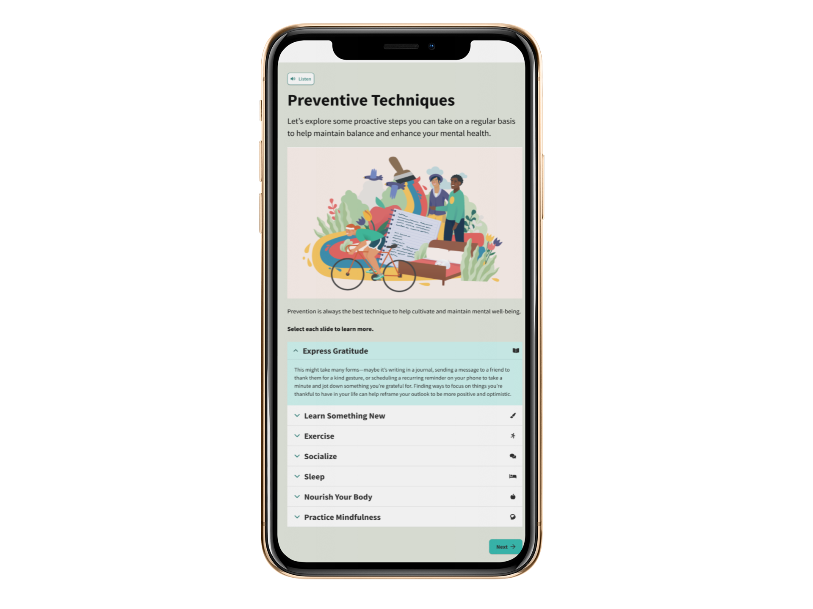
You’ve been there for others. Now it’s time to be there for YOU.
Educators and school professionals are struggling with their mental health.
Our educators and staff are often so busy providing support to children, they might overlook care of their own mental well-being. In a recent study, nearly three-quarters of teachers and 84% of school leaders described themselves as “stressed”, and more than a third of professionals have experienced a mental health issue in the past academic year.
Sponsor logo

Slide 2
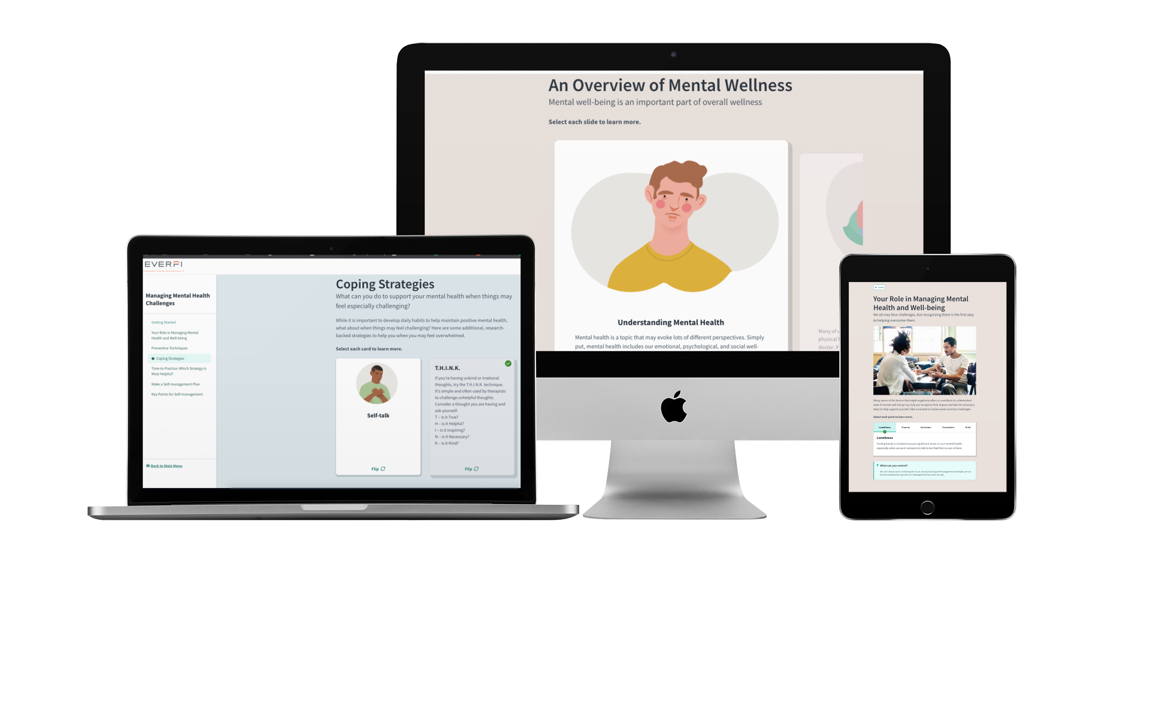
Elevate for Educators
[Sponsor Name] is committed to supporting educator mental well-being by providing evidence-based, actionable learning solutions through EVERFI Elevate at no charge to our teachers.
Content Library
Through a 5-10 minute learning sequence, learners will gain the understanding of:
Mental Well-Being for Educators
Managing Mental Health Challenges
Mindful Living
Developing Coping Skills
Supporting a Friend or Loved One
Building Strengths & Developing Motivation
Strategies for Stress Management
[Sponsor Name] wants you to have the knowledge and skills you need to sustain and maintain the best version of yourself, both in and out of the classroom.
QR code goes here
Visit [www.URLgoeshere.com]
EVERFI, Inc. is the leading education technology company that provides real-world education to learners of all ages through innovative and scalable digital learning.
2300 N Street NW, Suite 500, Washington, DC 20037 (202) 871-9292

