Slide 1
Understanding Mental Wellness
The Understanding Mental Wellness curriculum is a digital program that teaches students the importance of paying attention to their mental health and the ways in which they can implement coping strategies to manage their own challenging thoughts, emotions, and behaviors.
Course Topics:
Introduction to Mental Health
Understanding Mental Health Challenges
Mental Health Coping Strategies
Staying Healthy in Times of Uncertainty
Seeking and Offering Help
Creating a Supportive Mental Health Plan
Grade Level: 8 - 10
Total Lessons: 6 digital lessons; 10-15 minutes each
Curriculum Fit: Health or Advisory
Standards Alignment: National Health Education Standards (NHES); State Academic Health Standards

Slide 2
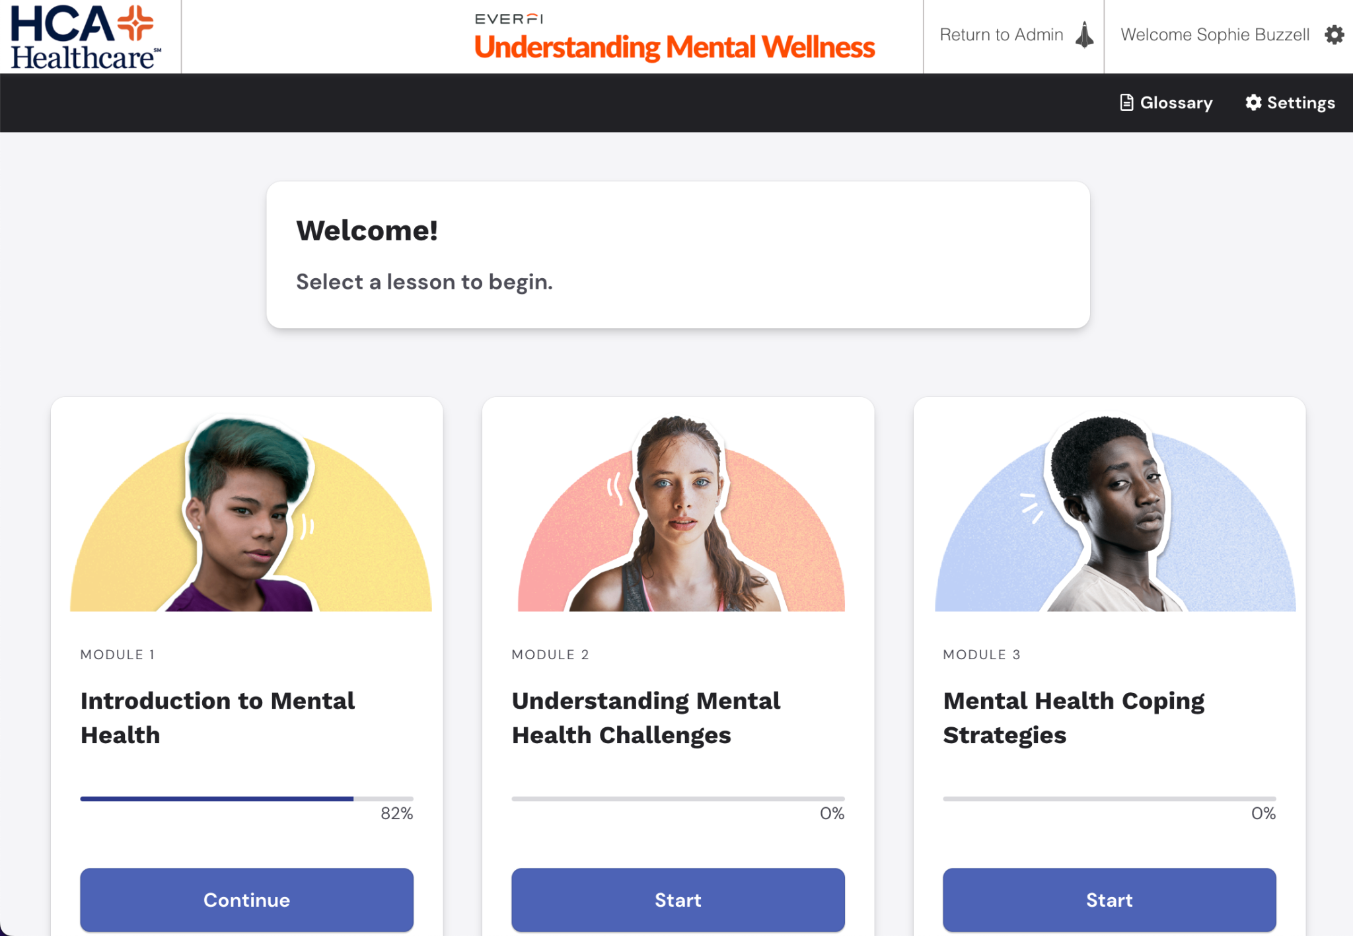
Understanding Mental Wellness
TOPIC AREAS AND DESCRIPTIONS
Introduction to Mental Health: Defining mental health, how the brain works, and impact of stress
Understanding Mental Health Challenges: Exploring mental illness and the impact of trauma
Mental Health Coping Strategies: Applying ways to maintain and improve mental health
Staying Healthy in Times of Uncertainty: Identifying and coping with unexpected events
Seeking and Offering Help: Understanding when to seek help and how to offer support
Interested in bringing this program to your school? Please contact [HCA Contact or EVERFI Contact at xxx]
Notes:
Teacher ratings.

