Slide 1
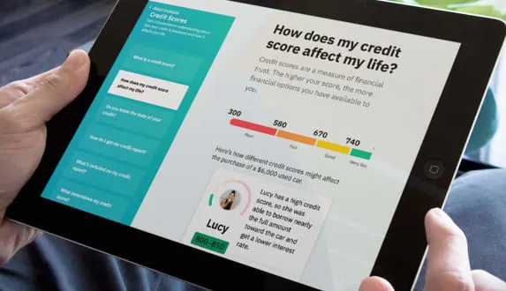




YOUR PROGRAM NAME HERE
YOUR LOGO HERE
FREE DIGITAL LESSONS
Learn how to manage and grow your money with [PROGRAM NAME]!
[PROGRAM NAME] is a digital financial education program designed to help you better manage your money. Get started today and take the first step in preparing for your financial future.
w
Learn More About:
Credit cards
Savings
Credit Scores & Reports
Building Emergency Savings
Checking Accounts
Auto Loans
Identity Protection
Considering Homeownership
Retirement 101
Budgeting Tool
Program Elements:
80+ financial education experiences 3-6 minutes each
Interactive, engaging, and mobile-first
Courses available in both English and Spanish
ADULT LEVEL EDUCATION
MOBILE FRIENDLY
SHORT MODULES
INTERACTIVE LEARNING
[PROGRAM URL]

