Slide 1
EVERFI: Financial Literacy® for High School
GRADE LEVEL:
9–12
LENGTH:​
11 digital lessons (20 min each) and up to 2.5 hr of learning
CURRICULUM FIT:
Economics, Financial Algebra, FCS, Business, AVID, and Advisory
STANDARDS ALIGNMENT:
Jump$tart National Standards in K–12 Personal Finance Education
A Letter from Your Sponsor
We are so pleased you have discovered the EVERFI: Financial Literacy program. We believe success begins with a solid understanding of key financial concepts which is why we proudly sponsor this engaging program designed to help empower students with the knowledge and skills they need to make informed financial decisions throughout their lives.
As your students progress through the modules, we encourage them to reflect on how the essential skills taught in this course will better equip them to handle future financial challenges. Skills like avoiding debt, developing good habits like saving and budgeting, building and maintaining good credit, and preparing for life after high school, whether that involves further education or entering the workforce.
We appreciate the commitment you have made to your students and look forward to supporting their journey to financial success!
[INSERT DIVISION LOGO]
[INSERT CUSTOM PHOTO]
Please feel free to reach out to [CONTACT NAME] at [ORGANIZATION] or Chris O'Reilly at EVERFI to learn more about the courses or to arrange a presentation.
,
Contact Us
Sponsor Contact: [CONTACT EMAIL]
EVERFI Contact: Coreilly@everfi.com

Slide 2
Venture:
Entrepreneurial Expedition for Middle and High School
GRADE LEVEL:
7-10
LENGTH:​
4 digital lessons (20 min each) and up to 1.5 hr of learning
CURRICULUM FIT:
Business and Entreprenurial
STANDARDS ALIGNMENT:
Math Common Core Standards and ELA Common Core Standards
A Letter from Your Sponsor
We are so pleased you have discovered the Venture: Entreprenurial Expedition program. We believe learning about entrepreneurship equips students with critical thinking, problem-solving, innovation, and financial literacy skills, while also fostering resilience and adaptability.
As students progress through the modules of this course, we encourage them to explore diverse career opportunities and to allow themselves to think entrepreneurially in both business and life.
We appreciate the commitment you have made to your students and look forward to supporting their journey to financial success!
[INSERT DIVISION LOGO]
[INSERT CUSTOM PHOTO]
Please feel free to reach out to [CONTACT NAME] at [ORGANIZATION] or Chris O'Reilly at EVERFI to learn more about the courses or to arrange a presentation.
,
Contact Us
Sponsor Contact: [CONTACT EMAIL]
EVERFI Contact: Coreilly@everfi.com

Slide 3
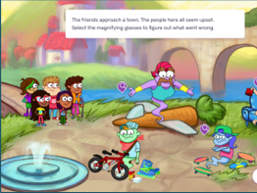
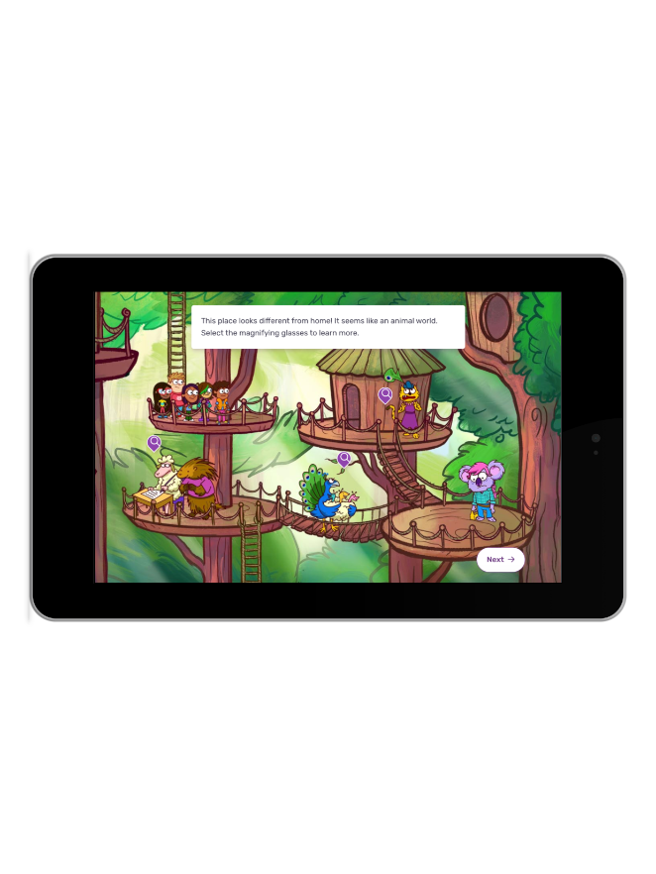
Vault: Understanding Money
for Elementary and Middle
GRADE LEVEL:
4-6
LENGTH:​
5 digital lessons (15 min each)
CURRICULUM FIT:
Social Studies, ELA, Math, FCE, CTE, Morning Meeting, and Library
STANDARDS ALIGNMENT:
Jump$tart National Standards in K-12 Personal Finance Education, Collaborative for Academic, Social, and Emotional Learning (CASEL) Competencies
A Letter from Your Sponsor
We are so pleased you have discovered the Vault: Understanding Money program. We believe introducing basic financial concepts at an early age can help lay the groundwork for a financially literate future generation.
As your students progress through the modules, we encourage them to reflect on essential money management skills such as saving, spending, and budgeting. Practicing critical thinking around these skills will help prepare them to make more informed financial decisions later in life.
We appreciate the commitment you have made to your students and look forward to supporting their journey to financial success!
[INSERT DIVISION LOGO]
[INSERT CUSTOM PHOTO]
Please feel free to reach out to [CONTACT NAME] at [ORGANIZATION] or Chris O'Reilly at EVERFI to learn more about the courses or to arrange a presentation.
,
Contact Us
Sponsor Contact: [CONTACT EMAIL]
EVERFI Contact: Coreilly@everfi.com

