Slide 1


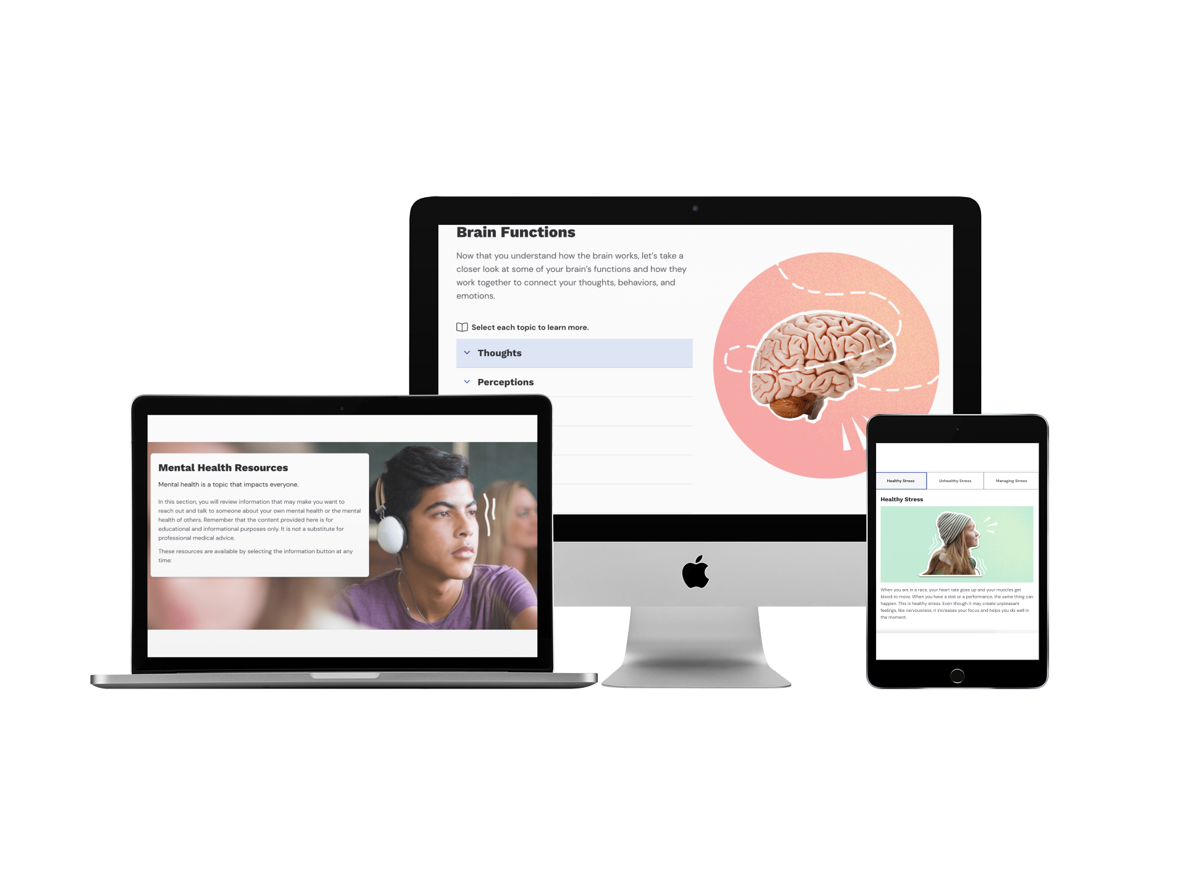
Understanding Mental Wellness
Hospital Logo Here
FREE DIGITAL LESSONS
Take Steps to Build Your Students’ Mental Wellness
The National Association of School Psychologists states, “According to the U.S. Department of Health and Human Services (2021), one in five children and adolescents experience a mental health problem during their school years.” Schools provide an ideal context for prevention, intervention, and positive development for students in the mental health space which can allow discussions around feelings and emotions become more natural for our nation’s youth.¹
The Understanding Mental Wellness curriculum is a digital program that teaches students the importance of paying attention to their mental health and the ways in which they can implement coping strategies to manage their own challenging thoughts, emotions, and behaviors.
www.nasponline.org¹
Grade Level: 8 – 10
Total Lessons: 6 digital lessons; 10-15 minutes each
Curriculum Fit: Health or Advisory
Standards Alignment: National Health Education Standards (NHES); State Academic Health Standards
THE LEARNING EXPERIENCE
EVERFI’s self-guided, interactive lessons help students develop simple, actionable strategies.
Real-world scenarios prime students for long-term behavioral change using problem-solving and self-reﬂection activities.
Detailed score reports and ofﬂine extension activities help teachers maximize their impact across all students.
To Learn More Visit:
https://everfi.com/courses/k-12/understanding-mental-wellness/
LESSON 1
LESSON 2
LESSON 3
LESSON 4
LESSON 5
LESSON 6
PRE-SURVEY
Introduction to Mental Health
Understanding Mental Health Challenges
Mental Health Coping Strategies
Staying Healthy in Times of Uncertainty
Seeking and Offering Help
Creating a Supportive Mental Health Plan
POST-SURVEY
EACH LESSON HAS A PRE- AND POST-ASSESSMENT WITH REAL-TIME SCORE REPORTING
Notes:
MF edited for no orange text

Slide 2
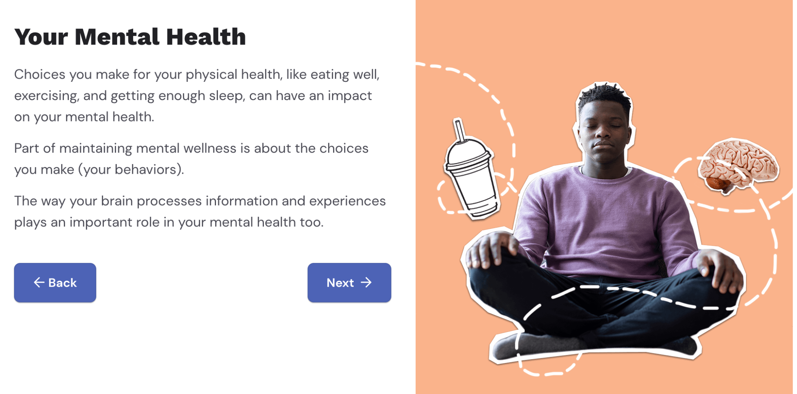
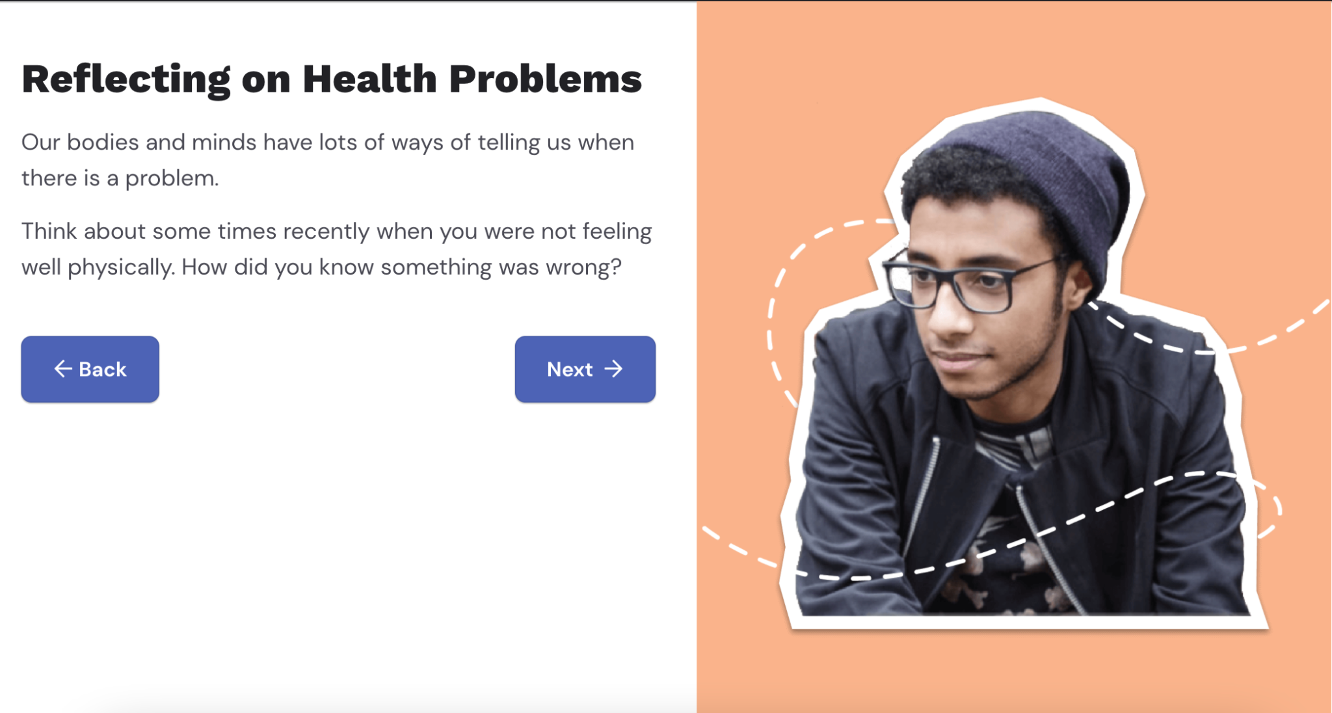
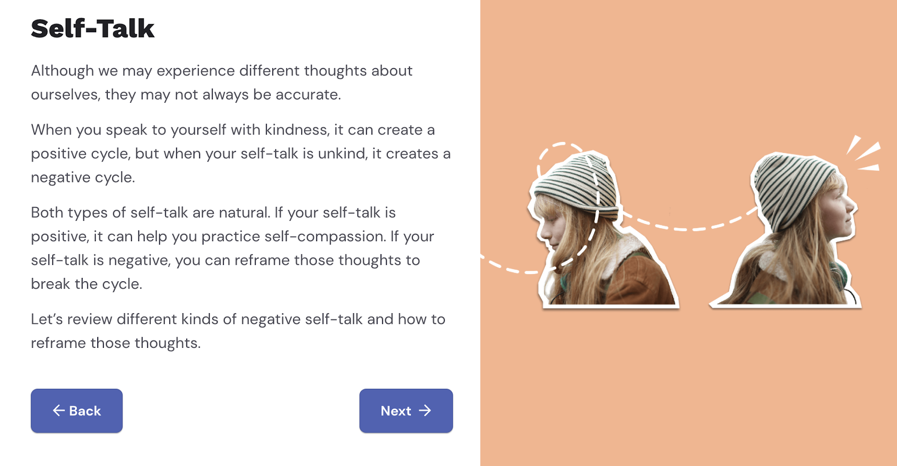
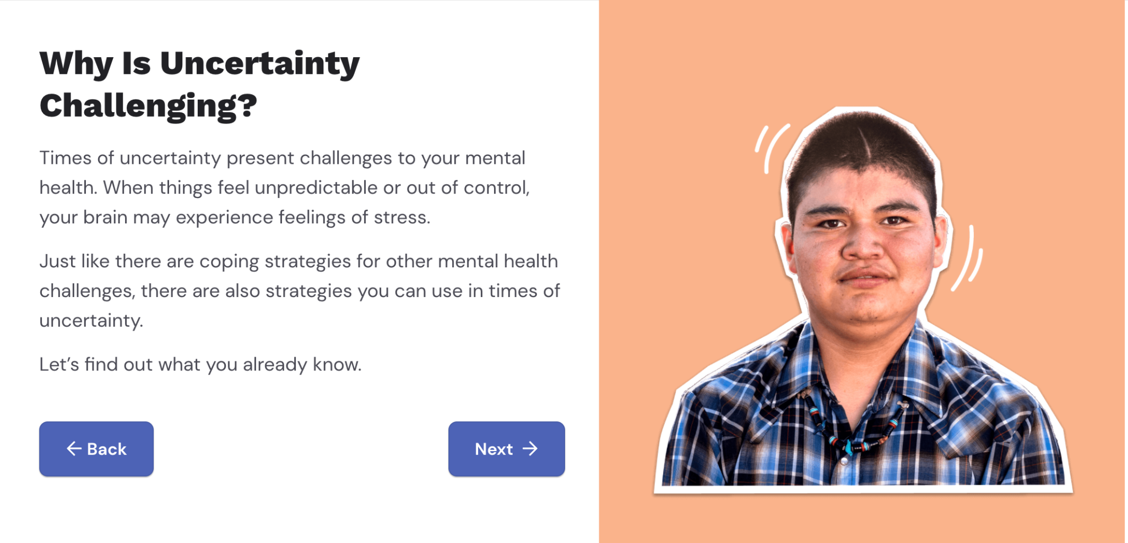


Hospital Logo Here
“Going through this EVERFI course and understanding causes of stress and mental illnesses made me more aware of my situation. I realized that I didn't have a balance and through this course, I was able to reduce stress by stabilizing my schedule, which almost immediately improved my overall well-being. “
— Alisha, High School student in New York
SAMPLE LESSON ACTIVITIES:
Introduction to Mental Health
LESSON SCOPE AND SEQUENCE
Introduction to Mental Health
Define mental health & list behaviors and factors that contribute to positive mental health
Define stress and explain how it interacts with mental health
List behaviors and factors that threaten mental health
Activity: What is stress?
Understanding Mental Health Challenges
Identify warning signs of a mental health condition
Explain how the functions of the brain affect the emotional, intellectual, and behavioral actions of a person
Explain how trauma impacts mental and physical health
Activity: What does mental health mean to you?
Mental Health Coping Strategies
Identify emotional, intellectual, physical and social factors that can support or impact mental health
Explain how coping strategies & self-talk can impact mental health
Activity: Practice coping strategies
Staying Healthy in Times of Uncertainty
Understand how uncertainty and change impact mental health
Explain the ways that your environment and sudden life changes are connected to mental health
Examine the ways that basic needs are connected to mental health needs and overall health.
Activity: Developing resilience
Seeking and Offering Help
Identify warning signs of a mental health challenges
Identify how stigma prevents people from seeking support for mental health issues
List ways to combat the stigma of mental health issues & understand consequences of not seeking help for mental health issues.
Activity: Reducing stigma
6. Creating a Supportive Mental Health Plan
Understand signs of mental health distress
Understand available resources for support
Apply coping strategies like reframing negative self-talk
Evaluate ways to respond to others experiencing a mental health challenge
Activity: Create a mental health action plan
Understanding Mental Health Challenges
Mental Health Coping Strategies
Staying Healthy in Times of Uncertainty
Ready to Start? Register now at EVERFI.COM/NewTeacher
EVERFI empowers educators to bring real-world learning into the classroom and equip students with the skills they need for success - now and in the future. Three out of five U.S. school districts use EVERFI’s digital resources to teach topics like ﬁnancial literacy, social-emotional learning, career readiness, and prevention education.
EVERFI
2300 N Street NW Washington, DC 20037
(866)-384-9062
www.everﬁ.com/k-12
Notes:
MF updated back page to black text

