Slide 1




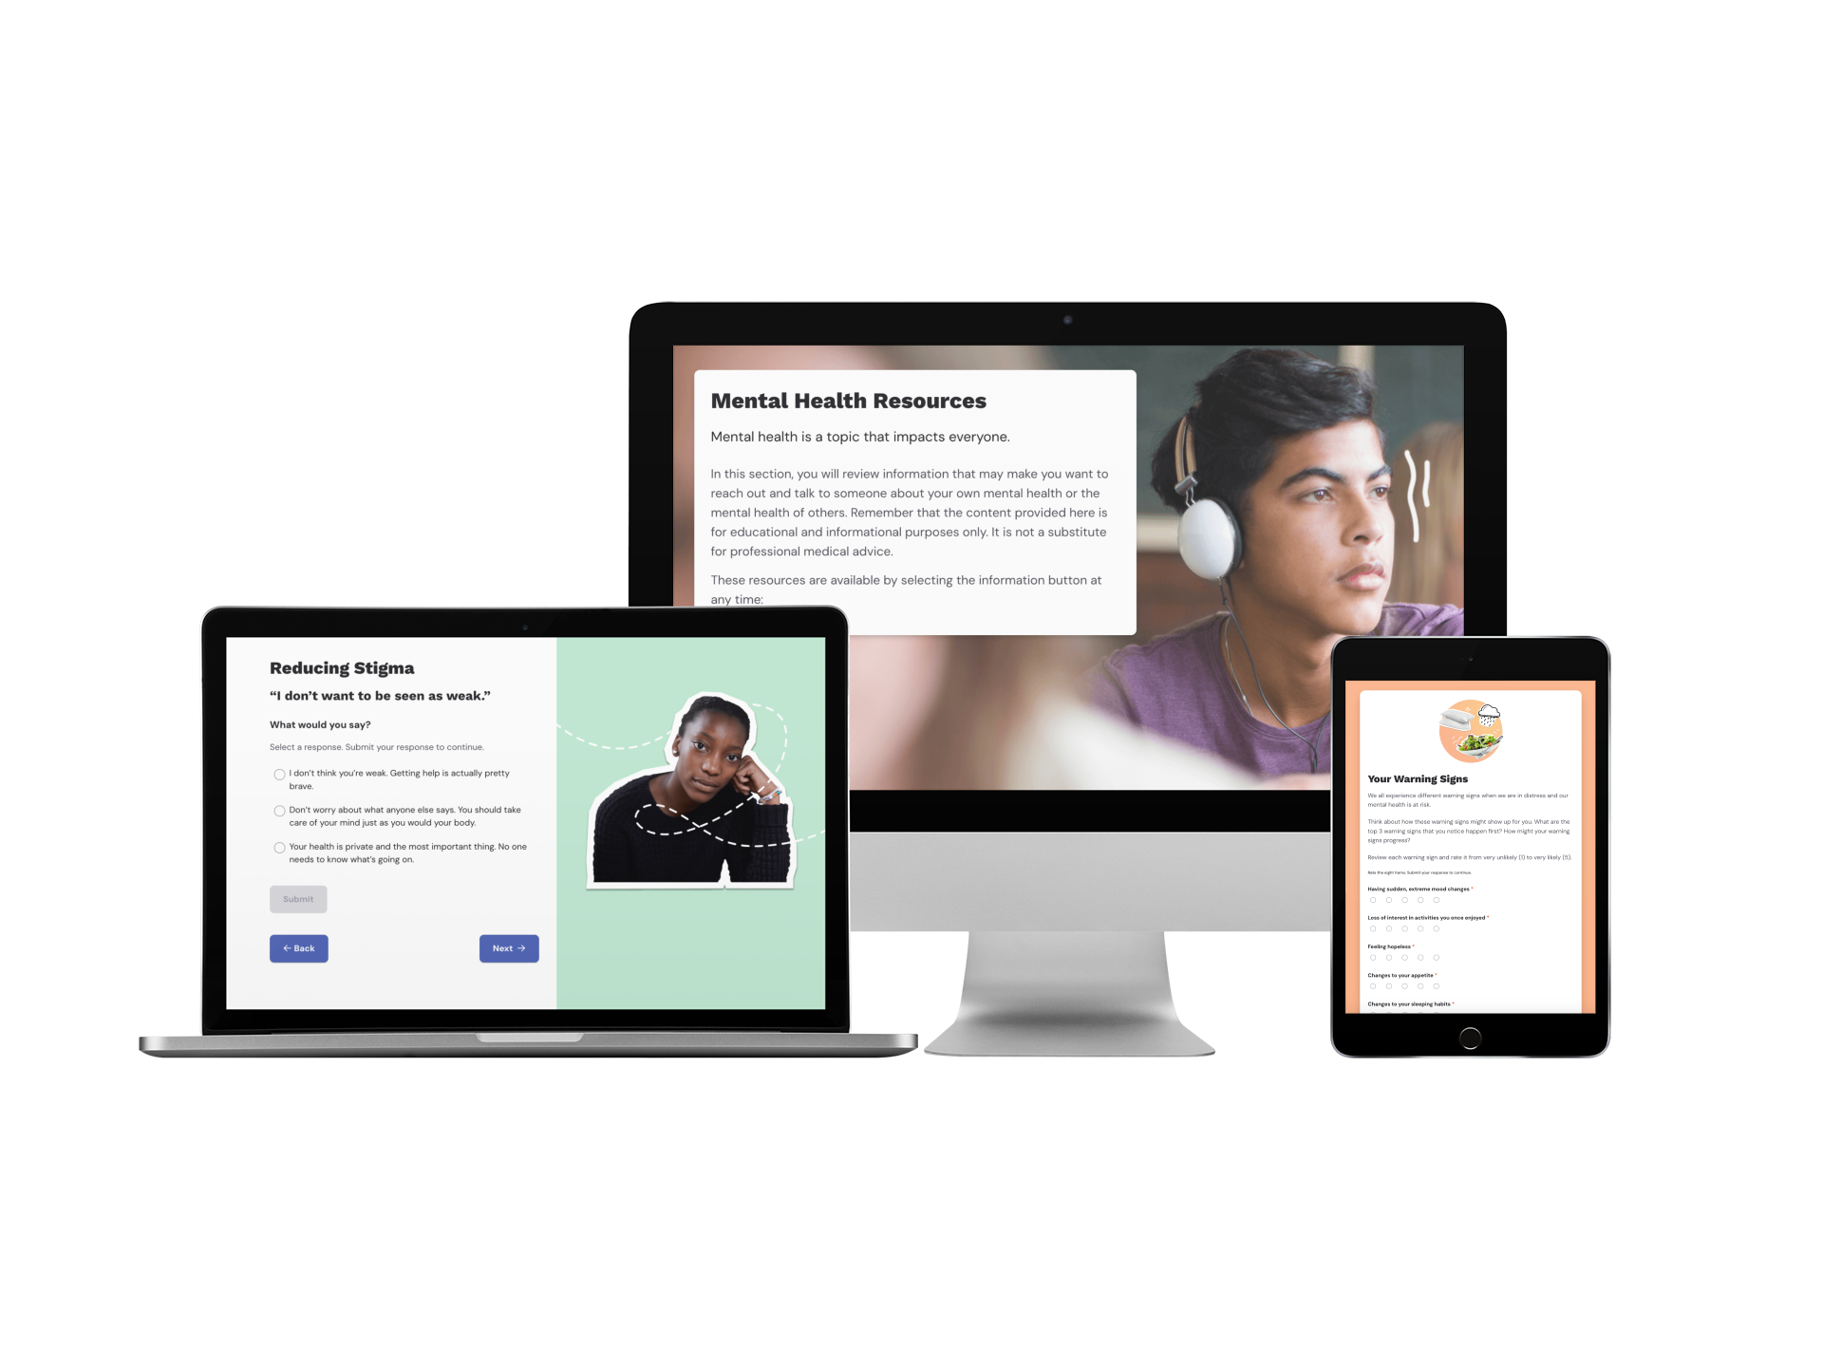











FREE DIGITAL LESSONS
Understanding
Mental Wellness®
According to the 2023 Youth Risk Behavior Survey (YRBS), 39.7% of high school students “experienced persistent feelings of sadness and hopelessness” and 28.5% “experienced poor mental health.”¹ Schools can play a vital role in reducing health risks among students, particularly in building supportive environments and fostering school connectedness; the YRBS found that students who reported high levels of school connectedness were associated with lower prevalence of all mental health and suicide risk indicators.¹
Understanding Mental Wellness is a free digital course that introduces students to the topic of mental health and how they can implement coping strategies to manage their own challenging thoughts, emotions, and behaviors. Through interactive real-world scenarios, students learn how to support friends and family who may be struggling, how to recognize when to seek help, and how to access appropriate resources to do so.
1. CDC, “Youth Risk Behavior Survey” (Source)
Understanding Mental Wellness
GRADE LEVEL:
8–12
LENGTH:
6 digital lessons (15 min each) and up to 3.5 hr of offline learning
CURRICULUM FIT:
Health, Counseling,
Advisory, Homeroom
STANDARDS ALIGNMENT:
National Health Education Standards (NHES)
EFFICACY:
Everfi courses are research-based.
Learn more at
everfi.com/research
Free Learning Platform & Support
PRE-SURVEY
Self-guided, interactive digital lessons with real-world scenarios
LESSON 1
Introduction to Mental Health
Offline lessons & resources to bring the digital lessons to life
LESSON 2
Understanding Mental Health Challenges
Built-in student assessments with automatic grading
LESSON 3
Mental Health Coping Strategies
MEASURABLE IMPACT
Evaluate learning gains with pre- and post-lesson assessment questions and real-time score reporting
Single sign-on (SSO) available to streamline student registration
LESSON 4
Staying Healthy in Times of Uncertainty
LESSON 5
Seeking and Offering Support
-and-
LESSON 6
Creating a Supportive Mental Wellness Plan
Regional team to support you every step of the way
POST-SURVEY

Slide 2
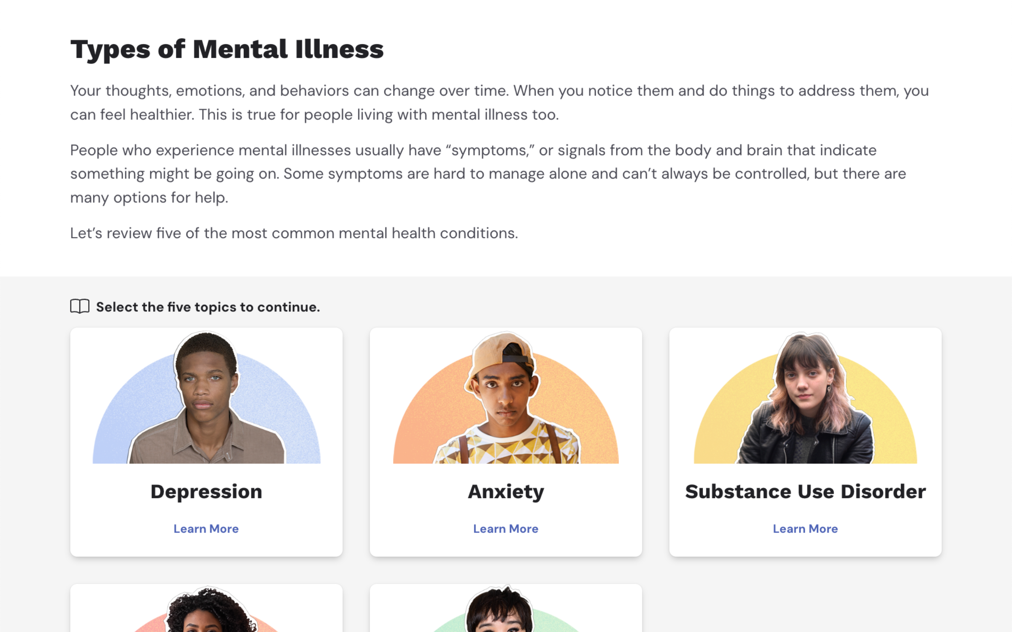
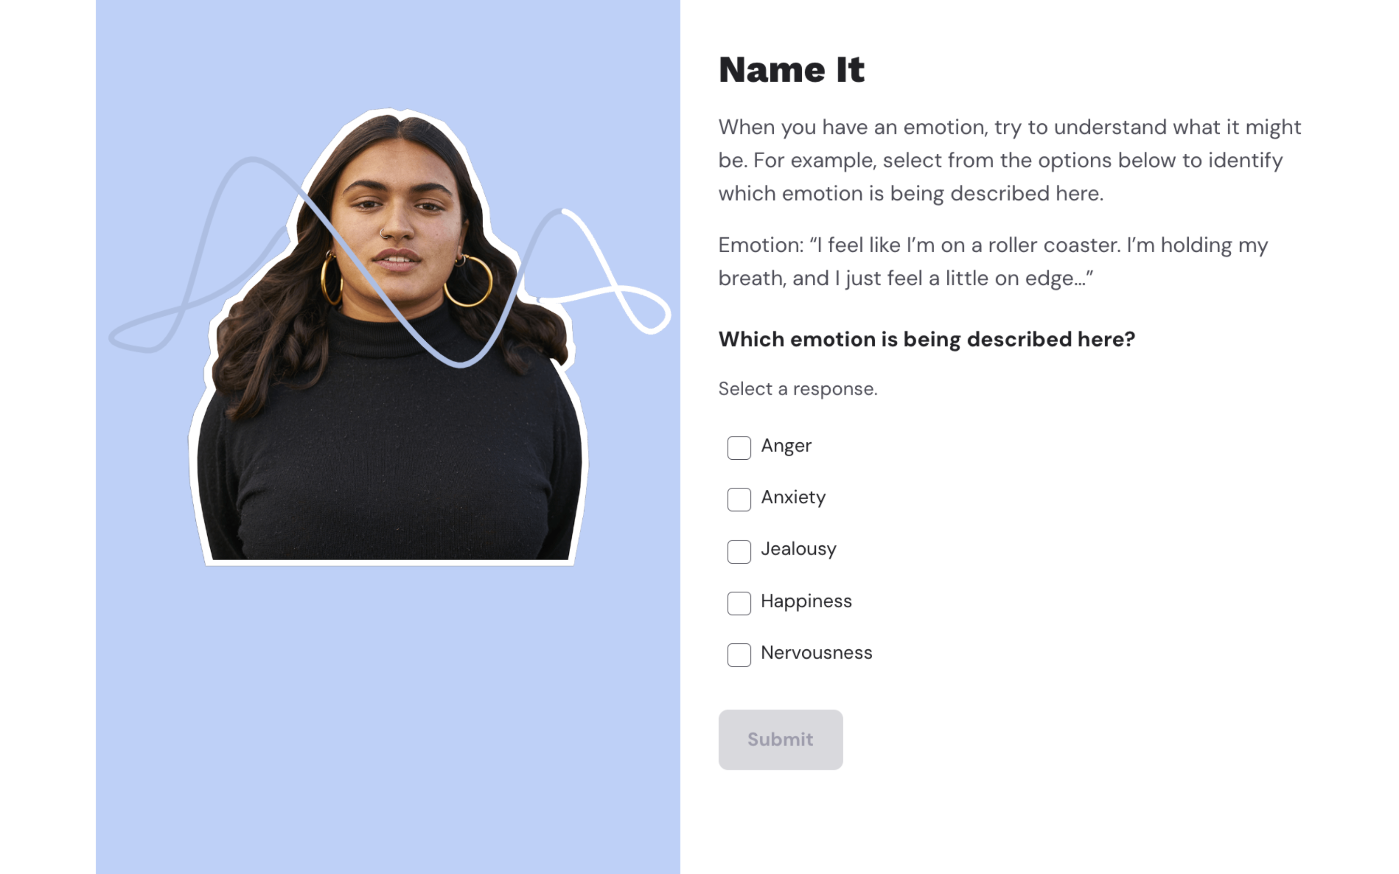
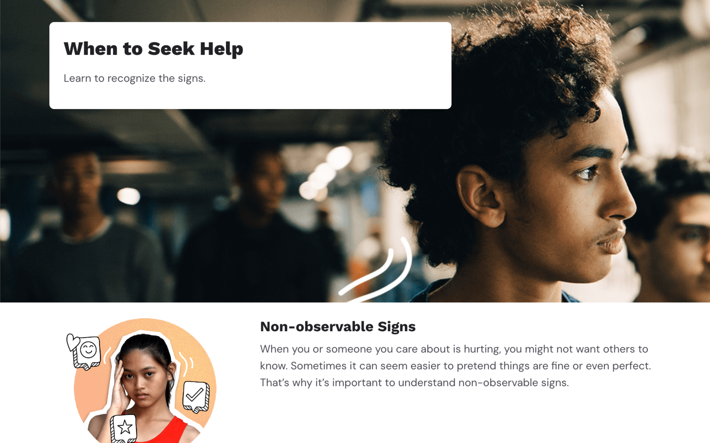
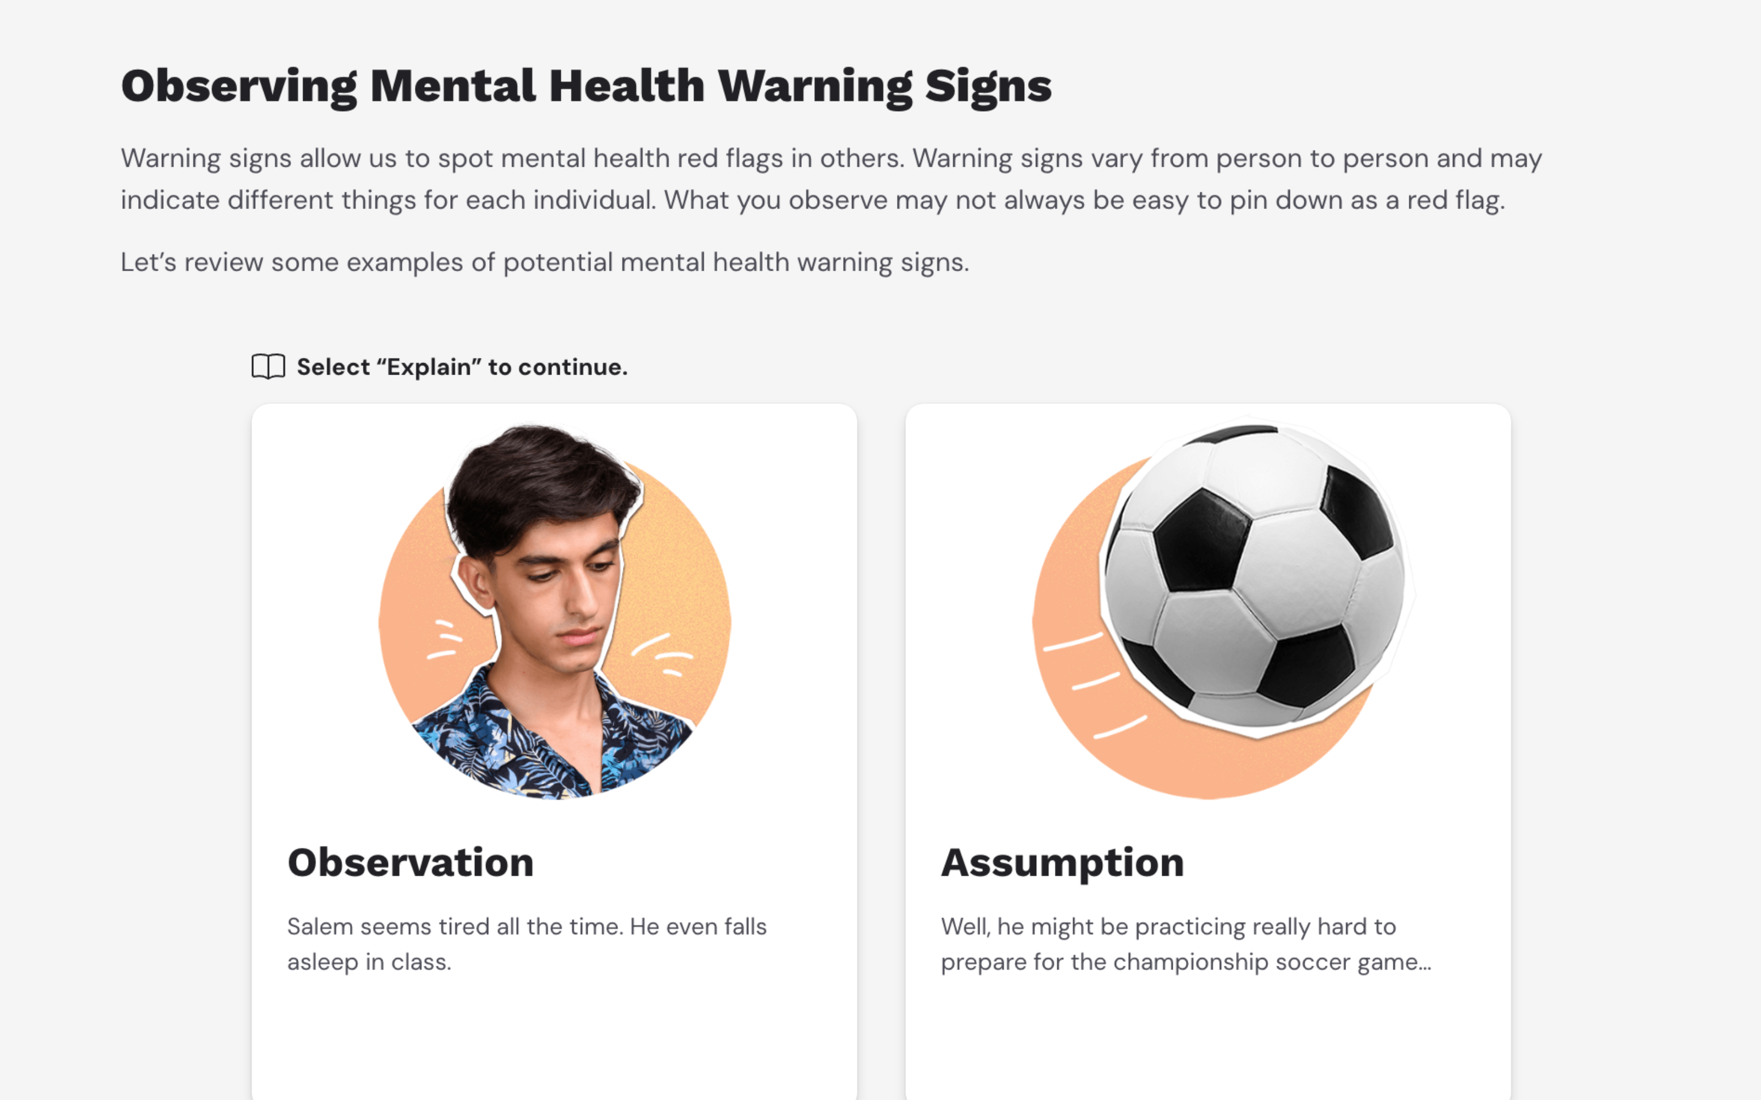


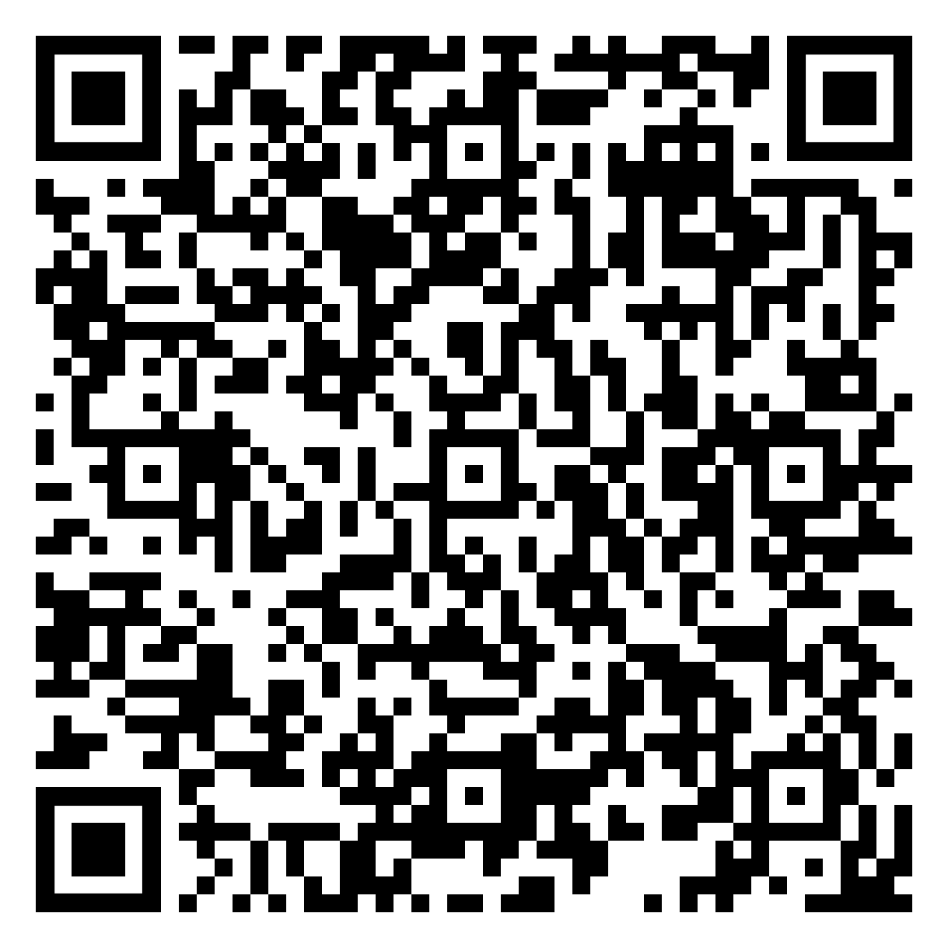
Understanding causes of stress and mental illnesses made me more aware of my situation. I realized that I didn't have a balance. Through this course, I was able to reduce stress by stabilizing my schedule, which almost immediately improved my overall well-being.
—High School Student, New York
Introduce Coping Strategies
To Help Students Manage
Their Emotions & Behaviors
Understanding Mental Health Challenges
Students identify warning signs of a mental health condition and explore how the brain is impaired in some common disorders that affect their age group.
Mental Health Coping Strategies
Students learn what coping strategies are and how they can be used to deal with life’s challenges and support mental health.
Seeking and Offering Support
Students learn how to recognize when help is needed and how to access it for oneself and to encourage others to seek help when needed.
Creating a Supportive Mental Wellness Plan
Students practice what they’ve learned throughout the course while also developing their own personal mental wellness strategy.
This course is a part of Everfi’s Health & Wellness Suite
Discover complementary courses covering topics like like prescription drug safety, health risks of cannabis use, vaping prevention, and navigating healthcare
Ready to start?
Register now at
everfi.com/newteacher
QR
LINK
Everfi empowers educators to bring real-world learning into the classroom and equip students with the skills they need for success—now and in the future.
(800) 945-2316

